Slide 1
Incorporating digital forensics capability into Our access Portfolio
Team Members:
Vignesh BALAKRisHNAN
Manish Jaiswal
Michael Rennie
Ranjeet Mani
Team Name: Cyber Knights
CATEGORY: Remote Access & Management
Location: Bangalore
Date: 13th Oct 2017

Slide 2



The Problem
Multiple products for IT infrastructure management with a lack of Endpoint Security focus

Slide 3
Market size
711mn devices
40mn devices
$2.28bn by 2021
CAGR of 25%
$749mn in 2016
Reports based on PRNewswire – published, Feb 9th, 2017, ,Dublin

Slide 4
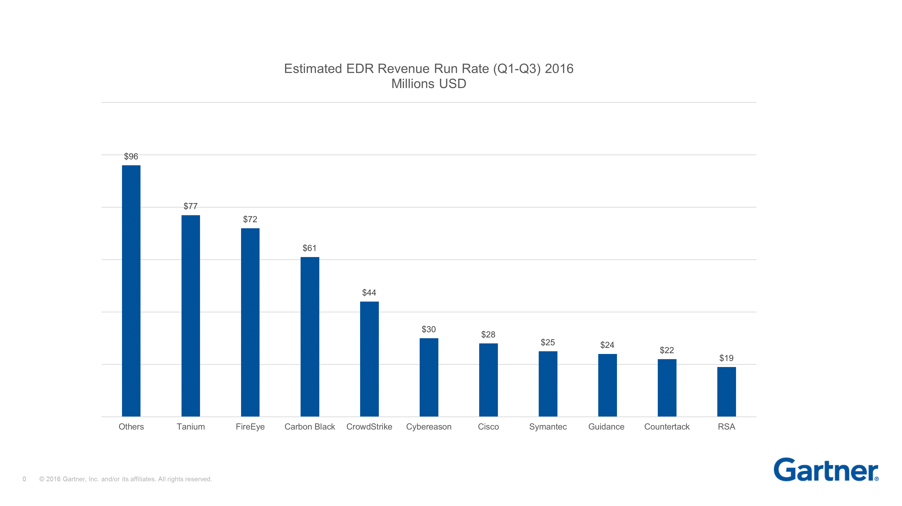
Competitor landscape

Slide 5
Market Validation
73% of companies – have deployed or are testing advanced anti-malware detection/prevention tools
59% of companies – have already implemented tools for end-point monitoring
69% of companies – have deployed endpoint forensic solutions to some degree
71% of companies – are integrating endpoint data with network security analytics
Reports based on Enterprise strategy group – Rethinking endpoint security - 2015

Slide 6



The Solution/Benefit to CUstomers
An online tool, integrated with CentralPro for users to gain fast, in-depth visibility into their network
Respond to alerts, identify & analyze
Single agent monitoring
Reducing the need for multiple security software

Slide 7
Benefit to customers
Single agent – reducing cost
Simplify and provide Real time analytics
Mitigate Risk & support Compliance

Slide 8
Add pic

Slide 9
Business model/Market adoption
Leverage on existing CentralPro customers
EDR to be provided as an add-on to customers
continuously monitor with a light weight tool

Slide 10
Competitive advantage
Bundled packaging
Reduced expenditure
Reduced manual process and controls

Slide 11
Product

